Slide 1




II Jai Sri GurudevII
Sri Adichunchanagiri Shikshana Trust®
SJB INSTITUTE OF TECHNOLOGY
BGS Health & Education City, Kengeri, Bangalore-560060
DEPARTMENT OF COMPUTER SCIENCE AND ENGINEERING
Project Review on
Privacy Preserving For The Frequently Generated Item By Using Cloud aided Service of a Transaction Database
Under the Guidance of:
Mr.Chandrashekar D K
Assistant Professor
Dept. of CSE, SJBIT
Presented by:
Bhavya Shree Y H
4th Sem M-Tech, CE

Slide 2
OUTLINE
Introduction
Problem Statement
Literature survey
Design Flow
Methodology
Screenshots
Conclusion
Future Enhancement
References

Slide 3
INTRODUCTION
Data
Data is not just a information.
Digital data is data that is represented using the binary number system of ones and zeros.
Big data
Extremely large data sets that may be analysed computationally to reveal patterns, trends, and association.
It is a massive volume of both structured and unstructured data .
It is so large it is difficult to process using traditional database and software techniques.

Slide 4
Cont…,
4Vs (Volume, Variety, Velocity and Veracity) are four defining properties or dimensions of big data.
Volume: Refers to the amount of data.
Variety : Refers to the number of types of data.
Velocity : Refers to the speed of data processing.
Veracity : Refers to the trustworthiness of the data.

Slide 5
Data mining
The practice of examining large pre-existing databases in order to generate new information.
Used to find actionable information from large sets of data.
Data cleaning, data integration and data transformation.
Various applications like market analysis, corporate analysis and fraud detection.

Slide 6
Mining Techniques
Association rule mining and Frequent item set mining are two widely used data analysis techniques.
These techniques used to find frequently occurring data items and association relationship between data items.
Frequent itemset mining
Itemset that occur together in transactional dataset
Example consider milk and bread are brought together in market.

Slide 7
Cont…,
Association Rule mining
Used to find frequent pattern, correlations, associations from datasets of relation database.
Example {bread,butter}=>milk.
Earlier algorithm like Éclat, FP-Growth are designed for centralized database and data stored in central site.

Slide 8
Problem Statement
Due to increased importance of data, many privacy preserving mining have been proposed but data owners who are having multiple data are not willing to send their data to central site due to privacy concerns so by using cloud-aided privacy-preserving frequent itemset mining solution for vertically partitioned database, build a privacy-preserving association rule mining solution.

Slide 9
Literature Survey
Title | objective | Methodology | Advantage | Disadvantage
Privacy preserving association rule mining in vertically partitioned data | Need to give Privacy for the data which is distributed over all the sites | Market based and clustering algorithm | Gives better privacy setting. Large data can be transmitted. | Duplication can be occurred. Leads to homogenous population. Unable to detect cross-site correlation.
Privacy-preserving mining of association rules from outsourced transaction database | How to secure the data from third party | Cryptographic notation schema | Easily identify the cipher items from patterns. Better security | Complex network analysis. Difficult to understands. Only considers encryption items

Slide 10
Performance Tuning of Steganography Algorithm For Privacy Preserving Association Rule Mining in Heterogeneous Data Base | Privacy concerns prevent centralized warehouse | Apriori algorithm for privacy | -it increase the performance -lead to give good privacy. | -not secure to maintain privacy of master sites.
Privacy-Preserving Computation of Bayesian Networks on Vertically Partitioned Data | If two clients have confidential data and do not want to leak that data. | Bayesian Network techniques | -It gives the better privacy setting. - Large data can be transmitted. | -only used for acyclic graph can not used for cyclic.

Slide 11
Design Flow
Big Data
Cloud
Preprocessing
Encrypt DB
Encrypted association rule candidates and verifying results
Outcome
Decrypt

Slide 12
Methodology
Apriori Algorithm
It is an algorithm for frequent item set mining and association rule learning over transactional databases.
It uses a "bottom up" approach.
Apriori uses breadth-first search and a Hash tree structure to count candidate item sets efficiently.

Slide 13
Apriori example
TID | List of items
T100 | I1,I2,I5
T200 | I2,I4
T300 | I2,I3
T400 | I1,I2,I4
T500 | I1,I3
T600 | I2,I3
T700 | I1,I3
T800 | I1,I2,I3,I5
T900 | I1,I2,I3
Scan transaction
for count of
each candidate
Itemset | Sup.count
{I1} | 6
{I2} | 7
{I3} | 6
{14} | 2
{I5} | 2
Itemset | Sup.count
{I1} | 6
{I2} | 7
{I3} | 6
{14} | 2
{I5} | 2
Compare
with
minsup
Consider min sup=2

Slide 14
Item set | Sup.count
{I1,I2} | 4
{I1,I3} | 4
{I1,I4} | 1
{I1,I5} | 2
{I2,I3} | 4
{I2,I4} | 2
{I2,I5} | 2
{I3,I4} | 0
{I3,I5} | 1
{I4,I5} | 0
Compare
sup
with
mini sup
count
itemset
{I1,I2}
{I1,I3}
{I1,I4}
{I1,I5}
{I2,I3}
{I2,I4}
{I2,I5}
{I3,I4}
{I3,I5}
{I4,I5}
itemset | Sup.count
{I1,I2} | 4
{I1,I3} | 4
{I1,I5} | 2
{I2,I3} | 4
{I2,I4} | 2
{I2,I5} | 2

Slide 15
Sup
count
with
mini sup
itemset | Sup.count
{I1,I2,I3} | 2
{I1,I2,I5} | 2
itemset | Sup.count
{I1,I2,I3} | 2
{I1,I2,I5} | 2
itemset
{I1,I2,I3}
{I1,I2,I5}

Slide 16
Cont…,
Substitution Cipher:
A substitution cipher encrypts a message by substituting the units of the message with cipher text units according to a substitution alphabet.
To encrypt database ,all items in the database are replaced with their corresponding ciphertexts.
Frequency analysis, the analysis of frequencies of cipher text units or unit groups, has been used to break classical cipher.

Slide 17
Cont…,
RSA Encryption:
It is used to encrypt and decrypt messages.
it involve public key and private key.
Used for secure data transmission.
Private key used for authentication.
Cloud aided service:
Amazon web service is used to provide the cloud service.
It is used to store the data more securely.
S3 storage is used to store the encrypted data.

Slide 18
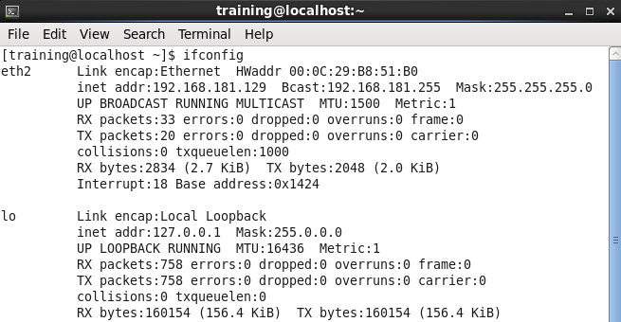
Screen shots
This shows the configuration of hadoop and the generation of ip address for the usage of putty and it will help to create session.

Slide 19
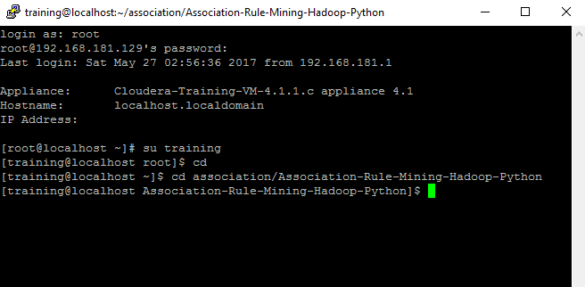
The putty session will be created and it will ask for user name and ask
password and then the initialization of the hadoop with executing simple commands.

Slide 20
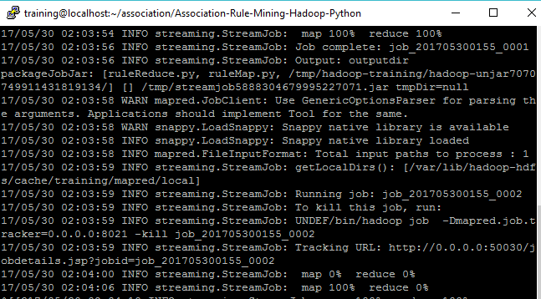
the execution of ruleGen.sh file which is used to delete the previously generated files and then generate the map reduce files which is of streaming information.

Slide 21
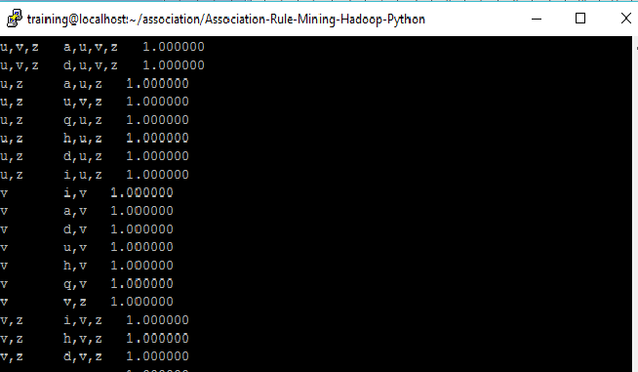
The itemsets in which are frequently generated using apriori algorithm
and it will generate frequent items based on minimum support count.

Slide 22
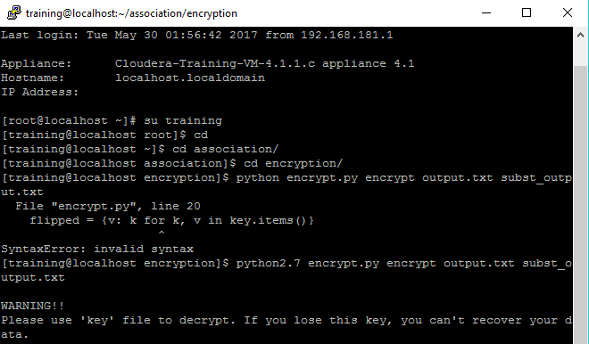
The substitution encryption for frequent itemsets and the key generation for the encrypted data.

Slide 23
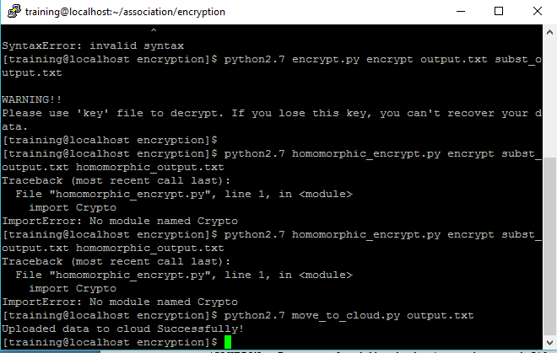
How the encrypted data will be moved to cloud using move to cloud program.

Slide 24
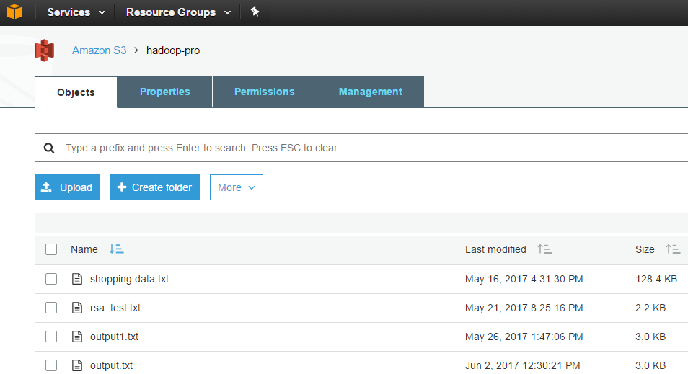
The encrypted data will be stored in AWS cloud . First AWS should create the bucket for the storage and then it will load the data to cloud.

Slide 25
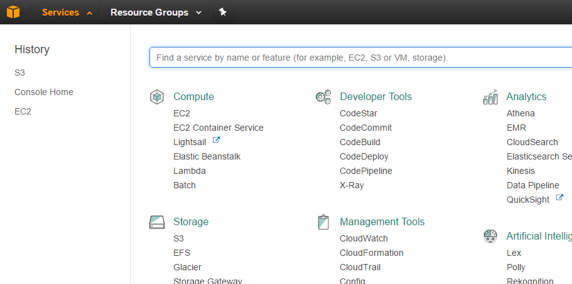
The AWS service provided for the used to store, develop and to compute the data. It will provide S3 and EC2 services.

Slide 26
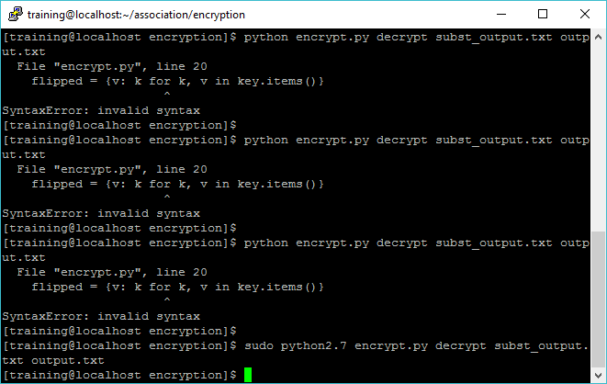
Decrypt the file from the cloud

Slide 27
Conclusion
Mainly for security the privacy is provided for frequent itemsets. By using cloud multiple data owner data is protected. When the raw data is compare with other data solution this solution provide less information and also this solution provide more efficiency so, this solution provide high privacy when the third party ready to access the raw data and it also avoid leakage.

Slide 28
Future Enhancement
By using this technology security is provided for multiple data owners and in future homomorphic encryption is used in cloud to provide high security and privacy. Homomorphic encryption is used to encrypt the data in plaintext and there will be symmetric and asymmetric encryption in this method.

Slide 29
References
[1]Privacy preserving association rule mining in vertically partitioned data. Jaideep Vaidya and Chris Clifton,purdure University west Lafayette,Indiana. Volume 3 Issue 5, May 2014
[2] Privacy-preserving Mining of Association Rules from Outsourced Transaction Databases Fosca Giannotti, Laks V.S. Lakshmanan, Anna Monreale, Dino Pedreschi, and Hui (Wendy) Wang. VOL. 7, NO. 3, SEPTEMBER 2013
[3] Performance Tuning of Steganography Algorithm For Privacy Preserving Association Rule Mining in Heterogeneous Data Base Mahmoud Hussein, Ashraf El-Sisi and Nabil Ismail Computer Science Department , Faculty of computers and Information, Menofyia University, Shebin Elkom 32511, Egypt.
[4] Privacy-Preserving Computation of Bayesian Networks on Vertically Partitioned Data Zhiqiang Yang and Rebecca N. Wright, Member, IEEE. VOL. 18, NO. 9, SEPTEMBER 2006

Slide 30
THANK YOU

